Slide 1

Data Bootcamp
Yelp Restaurants Business Data Project
BY YUE CUI, HEROPEIA HU, EWAN ZHAO

Slide 2
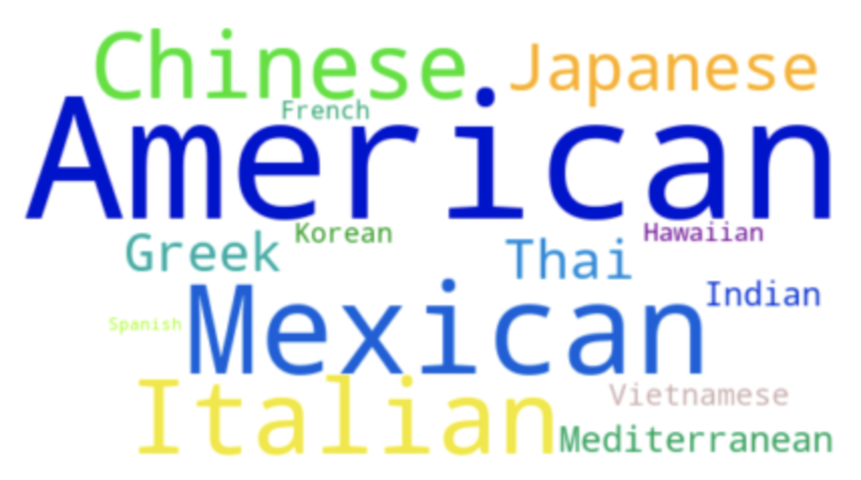
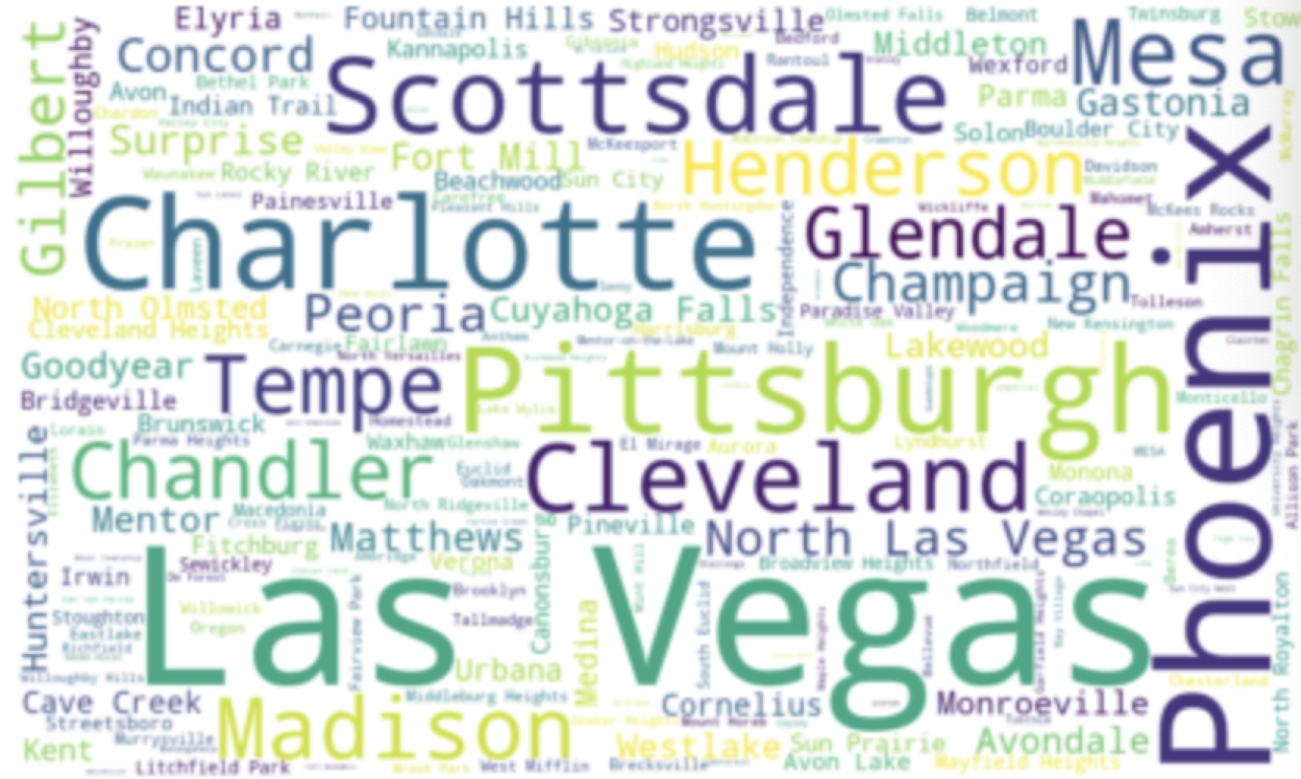
Business Case
Yelp connects people with great local businesses.
For customers, rating a business with stars and reviews helps elevate next experience.
For restaurant business owners, deciding on which business attribute to improve and cuisine type to provide is crucial to more positive feedbacks.

Slide 3
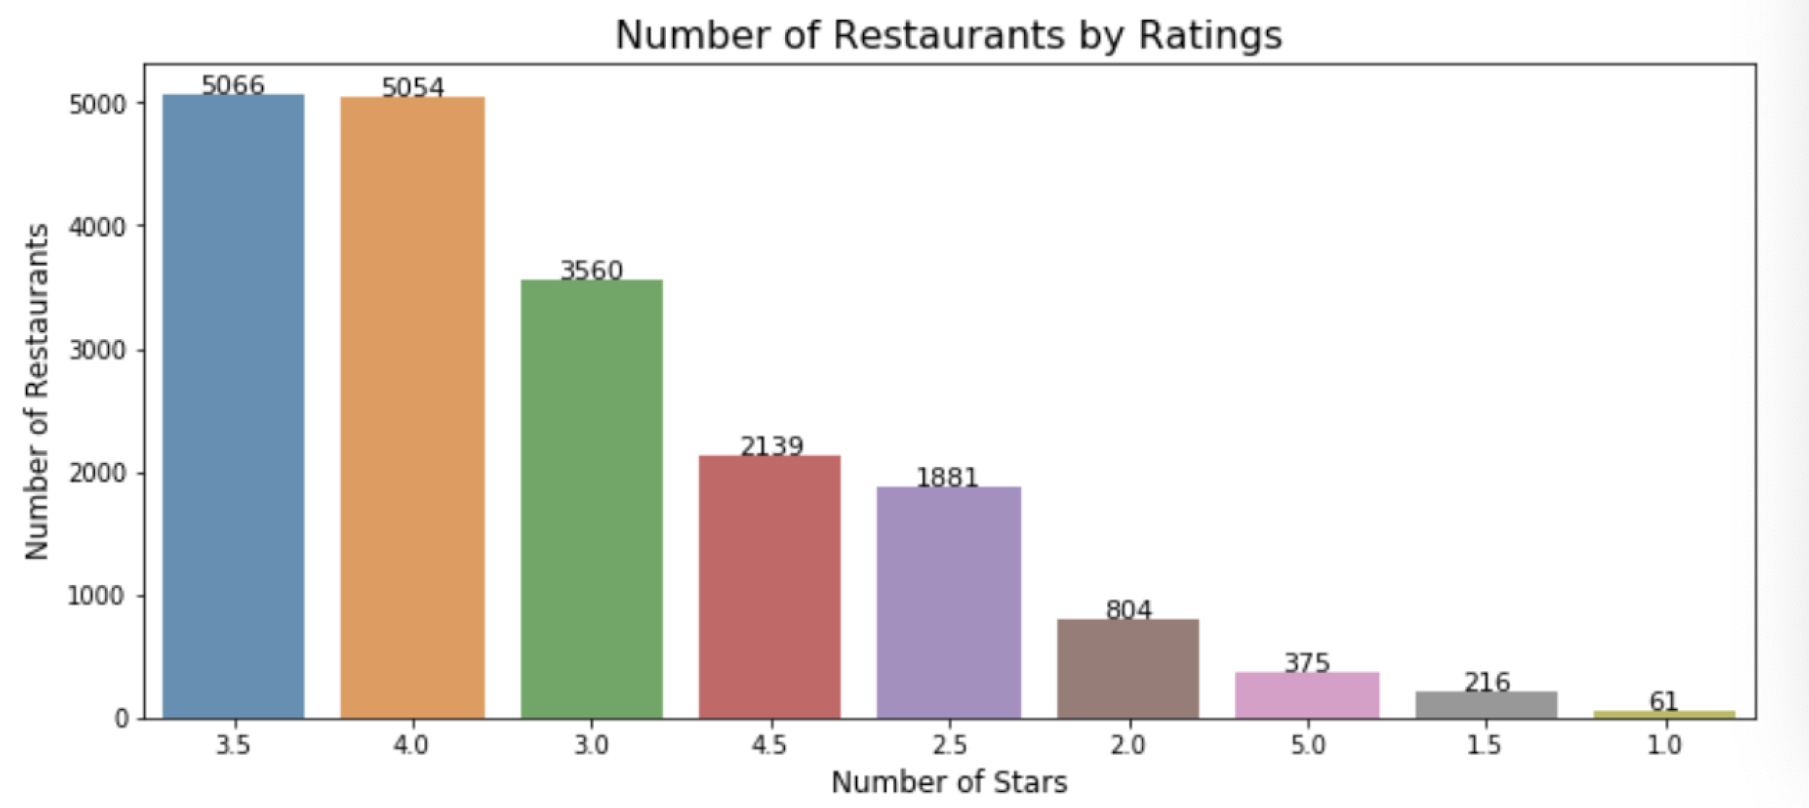
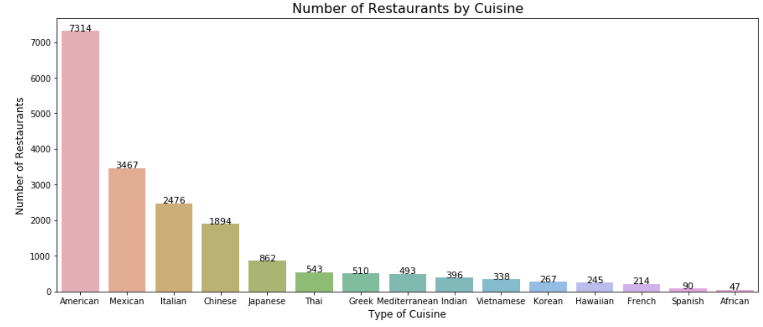
Ratings By Restaurants
There are only 375 restaurants winning full scores (5 stars) and 61 restaurants rated as 1-star. Over 10,000 restaurants are rated between 3.0 and 4.0 stars.
There are 7314 American restaurants, which tops other categories.

Slide 4
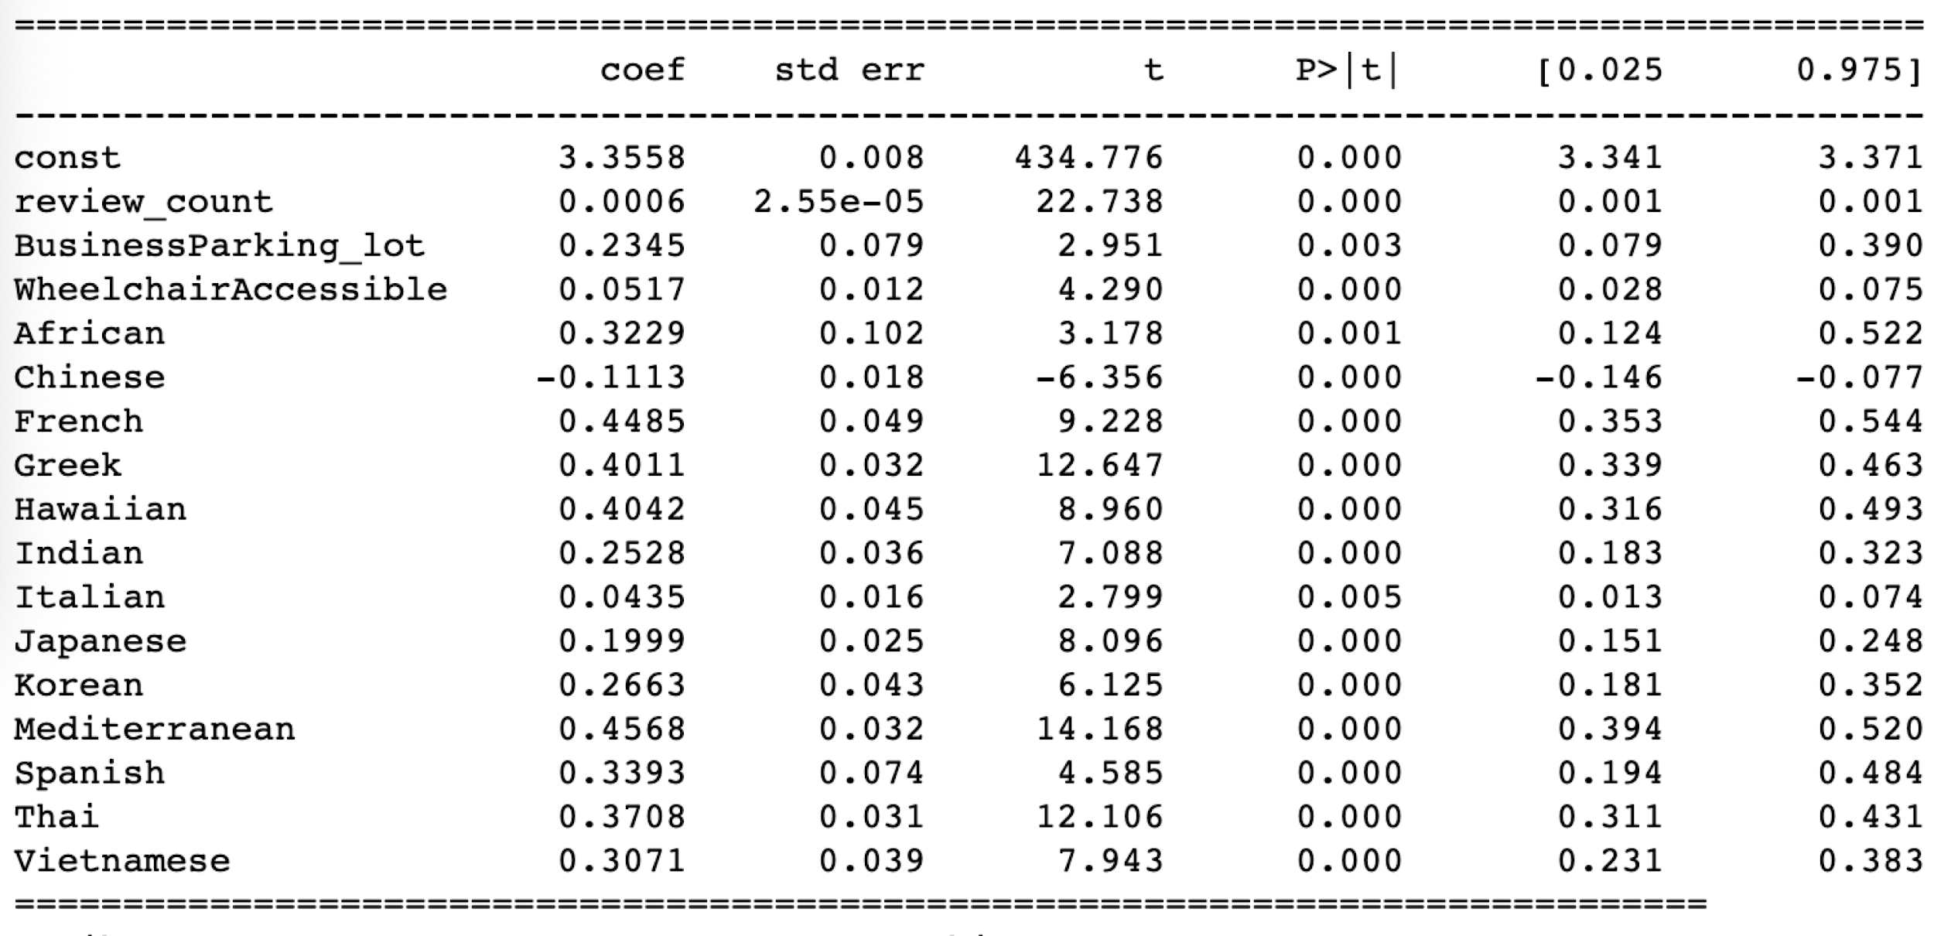
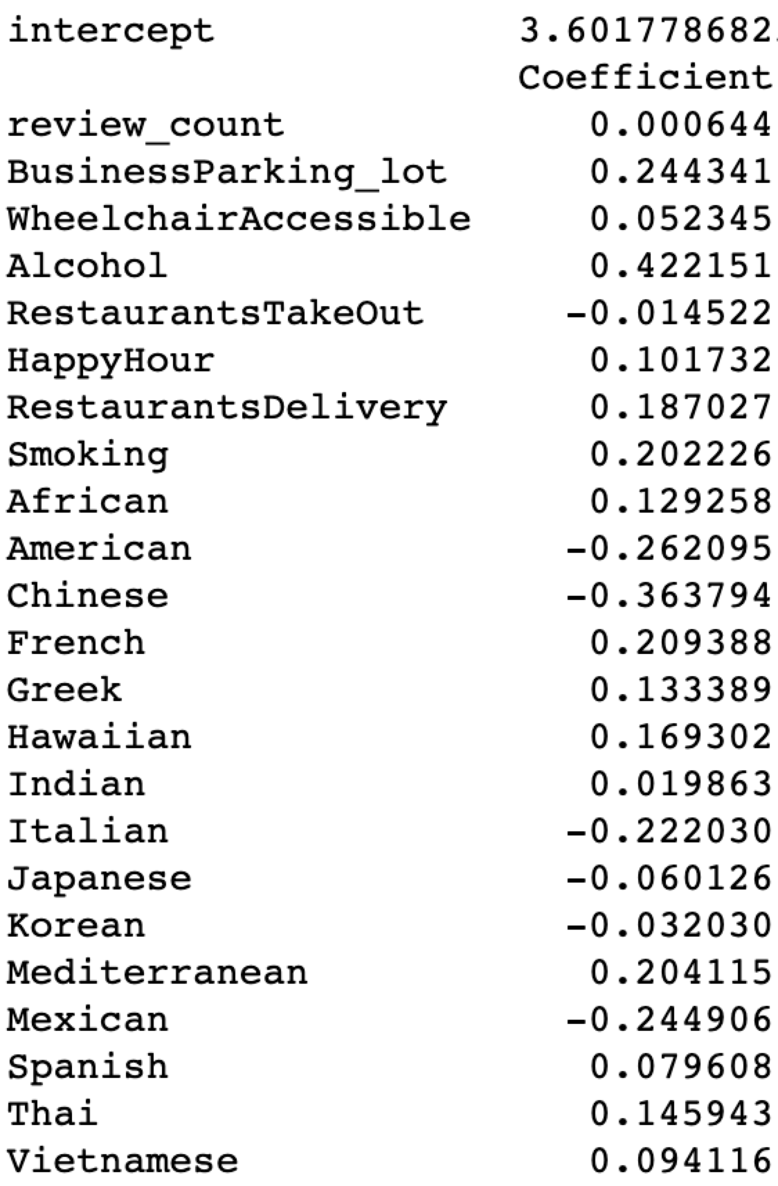
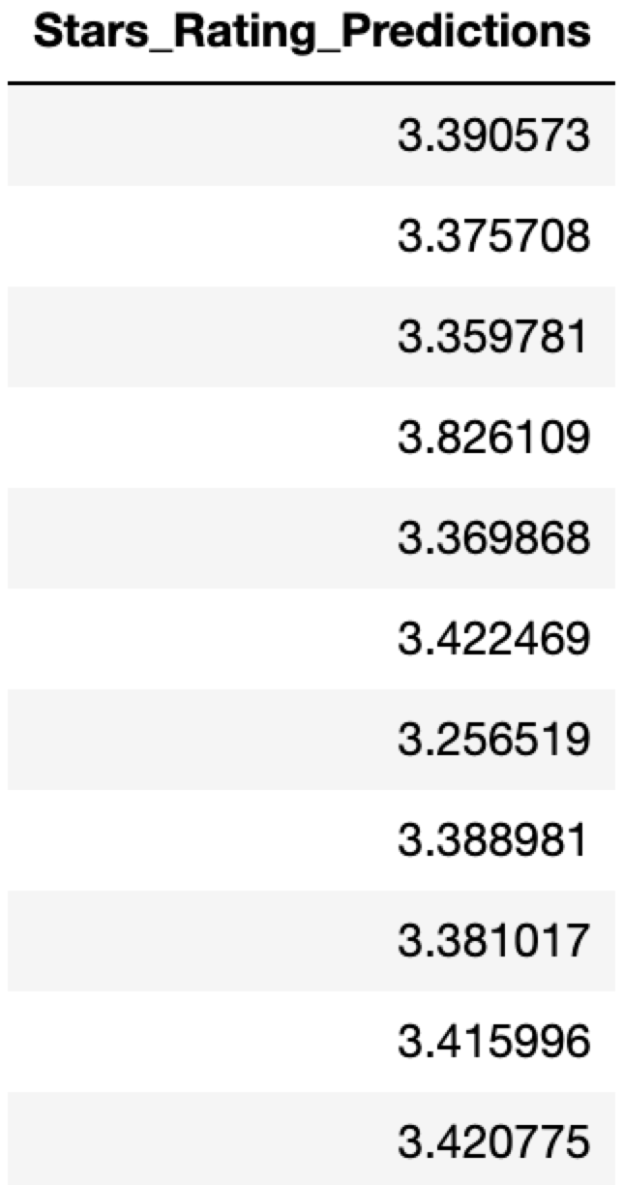
Ratings Prediction By Attributes & Cuisines
There are 16 variables that are significant in OLS model.
Scikit-learn/Linear Regression Model provides better prediction of stars rating for business owners

Slide 5
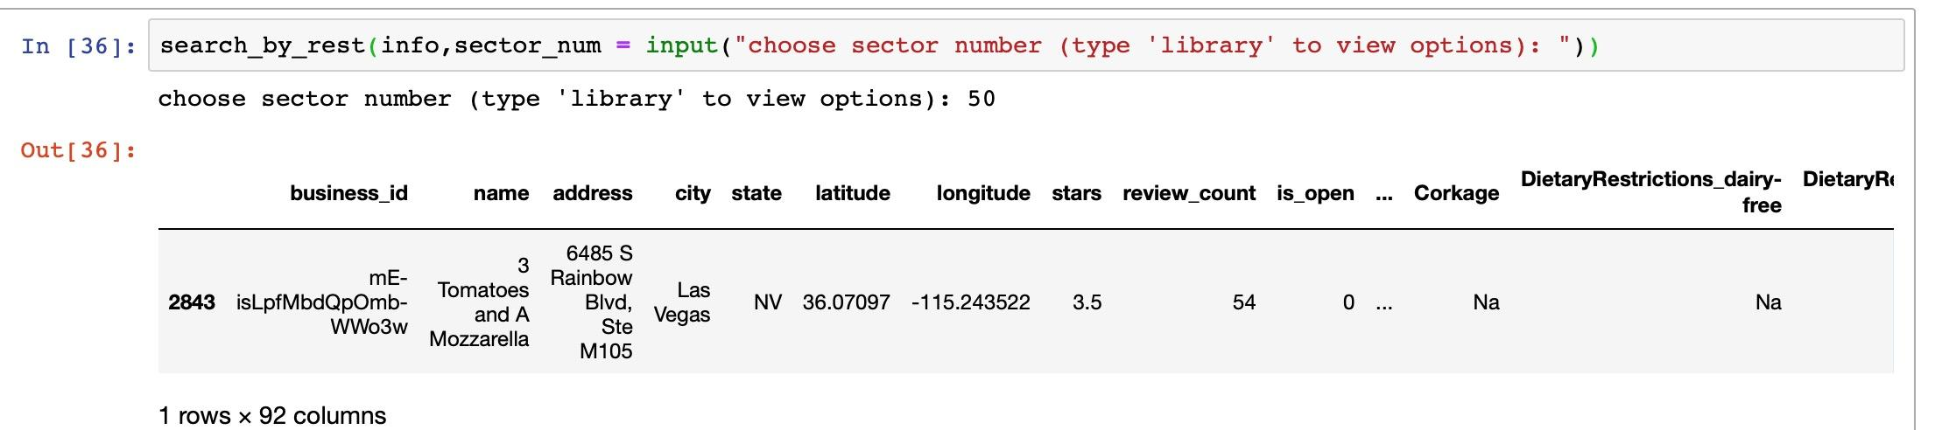
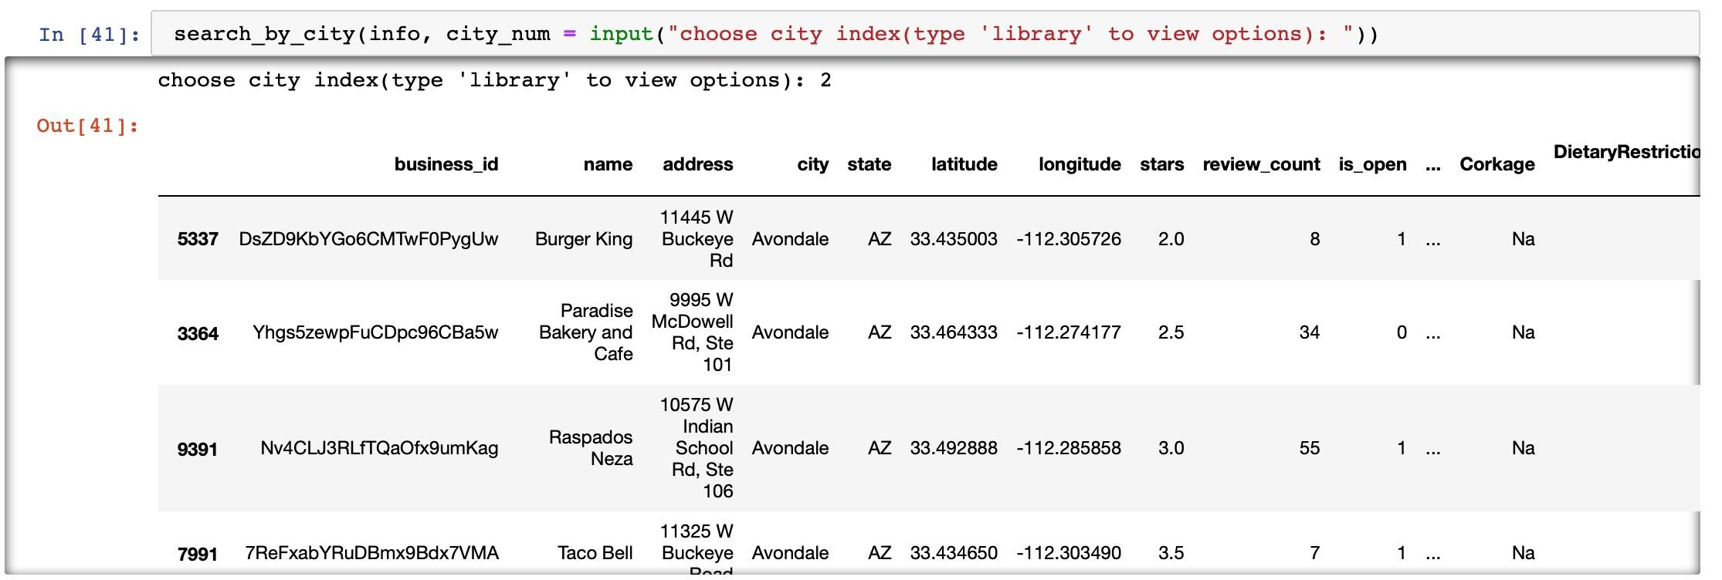
Recommendation of Local Restaurants
Based on Western Coast business attributes data,
we created user- defined-function to recommend customers with their inputs of restaurants names, cities, and parking facilities.

Slide 6
THANK YOU!

